Slide 1

Lightbend Reactive Platform
2016-03-11 / Jake Lee

Slide 2
Reactive System is Mainstream Trend

Slide 3
Reactive System is Mainstream Trend
Glossary
Reactive System is a Trend
Reactive Platform is a Product of Lightbend
Lightbend is a Company in US

Slide 4
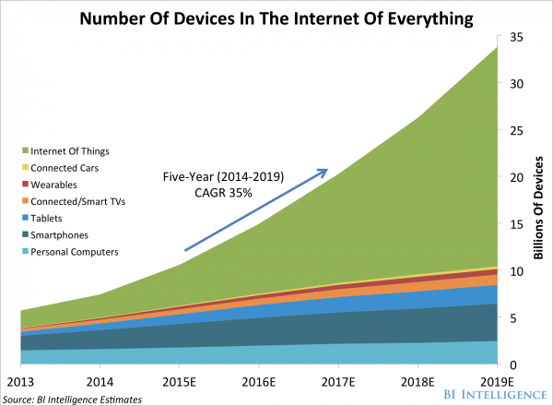
, ,
Big Data
IoT
Wearable
Smart TV
Tablet
Big Data
Smart Phone
PC

Slide 5
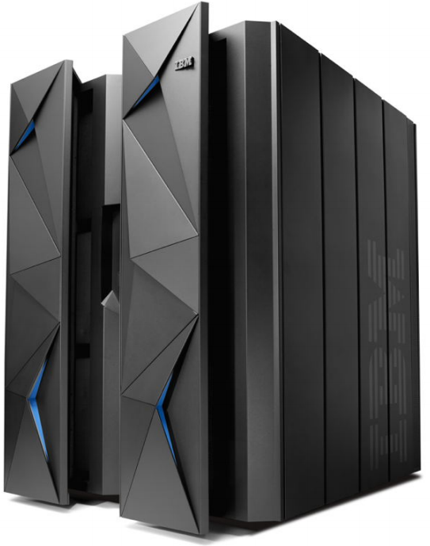
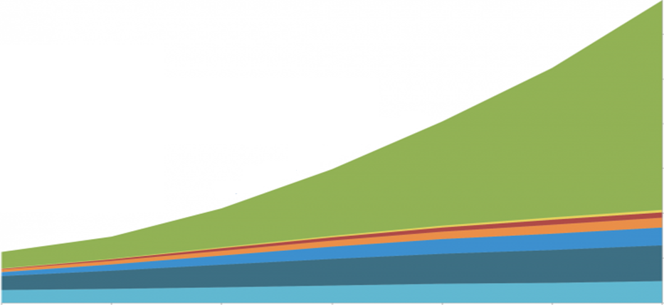

Reactive System is Mainstream Trend
Outdated - Monolithic System
Nonsupport Linear Scalability -> Need to buy Higher End Machine
Single Failure
Bottleneck
App
App

Slide 6
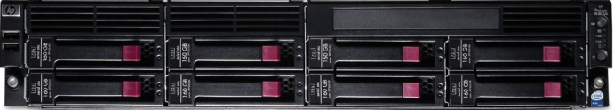
Reactive System is Mainstream Trend
Now – Microservice based Distributed System
Linear Scalability
Fault Isolation
Back-pressure -> Automatic Load-balancing
Actor
Actor
App
Actor
Actor
Actor
Actor
Actor
Actor
Actor
App
Actor
Actor
Actor
Actor
Actor
Actor
Actor
Actor
Actor
Actor
App
Actor
Actor
Actor
Actor
Actor
Actor
Actor
Actor
Actor
Actor
Actor
Actor
Actor
Actor
Actor
Actor
Actor
Actor

Slide 7
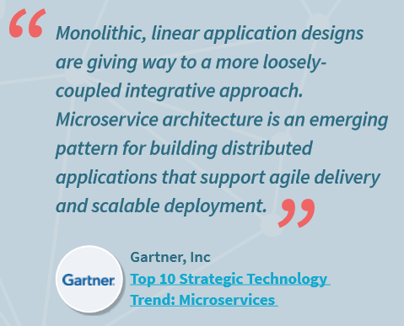
Reactive System is Mainstream Trend
Gartner : Top 10 Strategic Technology Trend for 2016
www.gartner.com/newsroom/id/3143521

Slide 8
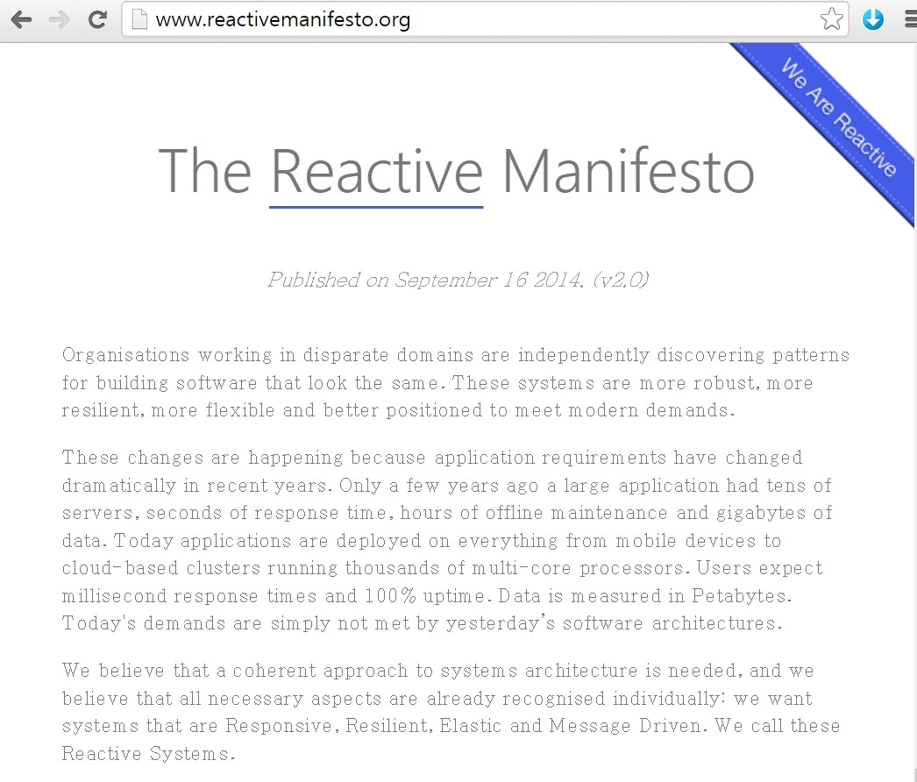
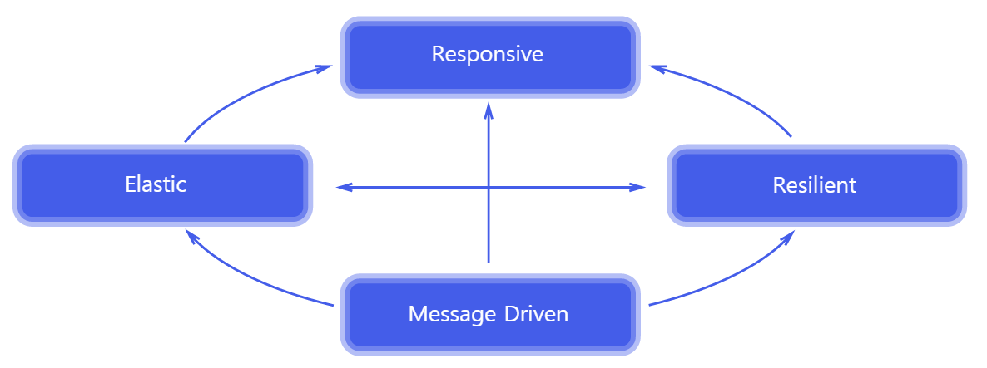
Reactive System is Mainstream Trend
The Reactive Manifesto
http://www.reactivemanifesto.org/
www.reactivemanifesto.org

Slide 9

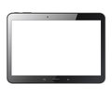



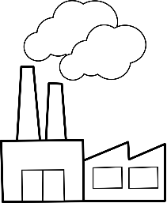
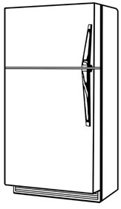

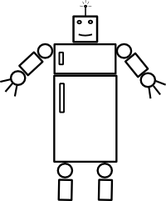

Reactive System is Mainstream Trend
What is Reactive System?
Reactive System is the system which is consistently responsive, highly resilient and elastic, by means of an asynchronous, non-blocking message-driven approach in a distributed environment.
Actor
Actor
Actor
Actor
Actor
Reactive System
Actor
Actor
Actor
Actor

Slide 10
Introduction to Product

Slide 11






Introduction to Product
Lightbend Reactive Platform
A Leading product in Reactive System area
Sub-products

Slide 12

Introduction to Product
Play
>
Don’t need WAS (Web Application Server)
Embedded Server
Asynchronous and Non-blocking IO
Java or Scala
App
Client
App
HTTP
AJAX
App

Slide 13
Introduction to Product
Akka
>
Distributed Framework on basis of replication and message-driven technology
External Producer
External Producer
Internal Producer
msg
msg
Router
Balancer
External Producer
Akka System
Akka System
msg
msg
Actor
Actor
Actor
Actor
Actor
Actor
Actor
Actor
Actor
Actor
Actor
Actor

Slide 14
Introduction to Product
Spark
>
Big Data Engine (De Facto Standard)
App
NoSQL /
RDBMS
query
query
Real-time streaming process

Slide 15
Introduction to Product
Scala
>
The most advanced Programming Language created in 2003
Pure Object-Oriented and Functional Programming Language
JVM based, Compatible with Java
Supports for Parallel Processing
Concise, Less Code
Designed by Martin Odersky
Designed Generic Java
Built the current Java Compiler
Co-founder of Lightbend

Slide 16
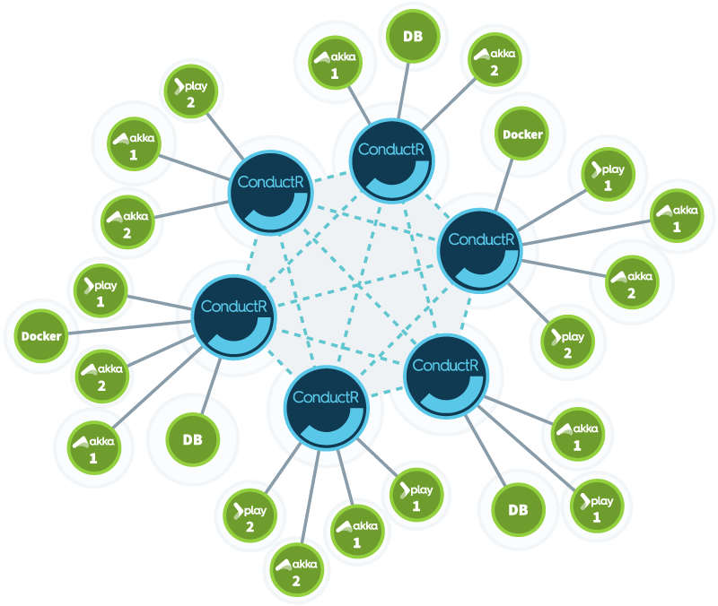
Introduction to Product
ConductR
>
Centralized Management for Distributed System
Deploy new app.
Rolling Upgrade
Removing app.

Slide 17
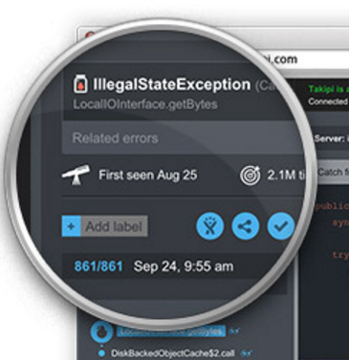
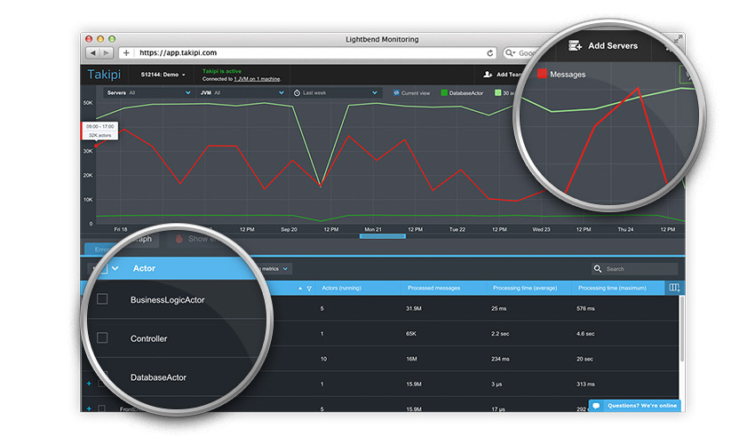
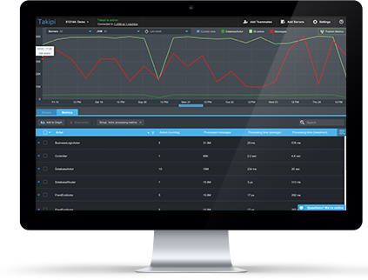
Introduction to Product
Monitoring
>
Centralized Monitoring for Distributed System
Errors
Traffic
Filtering

Slide 18
References

Slide 19
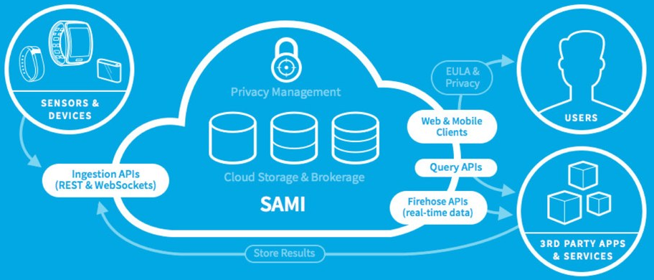
References
Infra-technology of Samsung SAMI
SAMI is Internot of Things(IoT) Platform to support developing and servicing
www.samsungsami.io

Slide 20









































References
Others
www.lightbend.com/resources/case-studies-and-stories

Slide 21
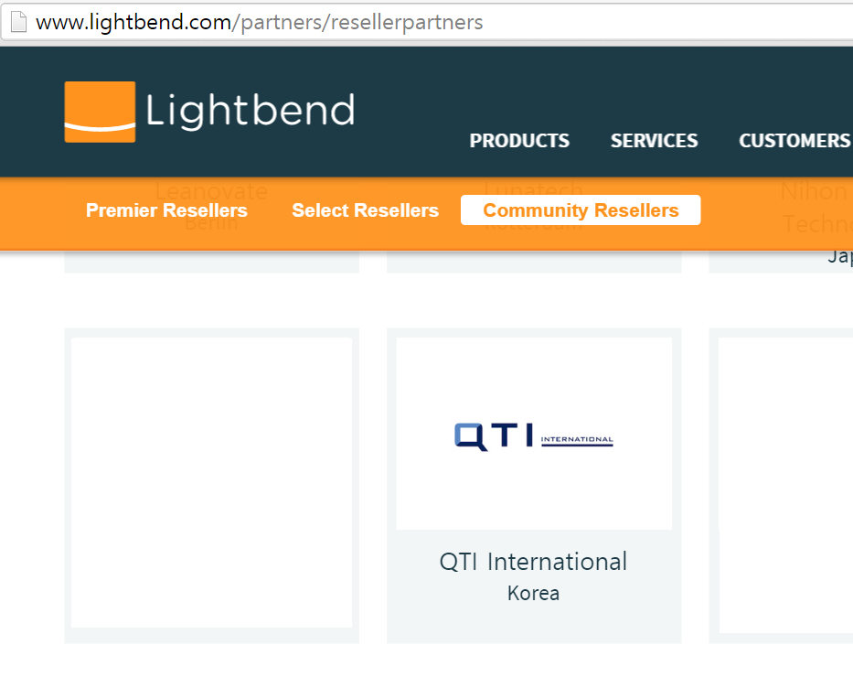
References
The Only Reseller of Lightbend in Korea
www.lightbend.com/partners/resellerpartners

Slide 22
Demonstration

Slide 23
Introduction to Product
Lightbend Reactive Platform
Sub-products

Slide 24
Demonstration
Demonstration of Elastic Server
Cached
SQL xml
Query
Service
(Built-in)
HTML5
Browser
H2
(DBMS)
Sample
Service1
(User Defined)
HTTP
AJAX
Sample
Service2
(User Defined)

